Slide 1

Customer Churn Analysis
Marketing Analytics
Group 3
Section 3

Slide 2






Meet the Team
Hewa Alegodage Nidula Chithwara
Shraddhaba Bharatsinh Jadeja
Harsimranjit Kaur

Slide 3

Customer Churn Analysis in E-Commerce
Customer churn occurs when consumer stops purchasing from a company. It is typically analyzed as the percentage of customers who have stopped purchasing from the brand over a certain period and is hence an important factor for the e-commerce businesses.
In this project, we have analyzed the data of an e-commerce business in depth using various machine learning techniques to understand the factors that have contributed the most in churning of the customers.
We will present our findings along with providing recommendations that are entirely data driven and would help the brand to retain its customers and lower the churn rate over a period.

Slide 4
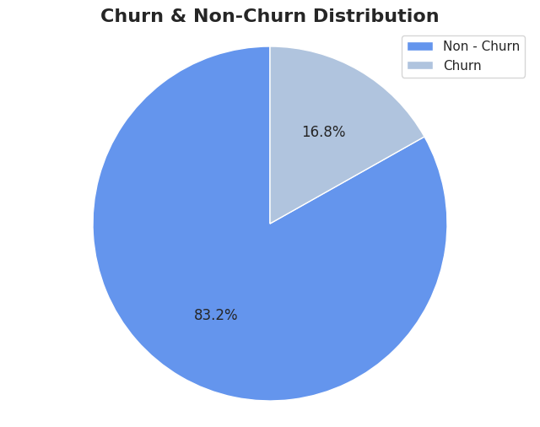
Analysis I – Churn and Non-Churn Distribution
Inference: As depicted in the pie-chart, our analysis has depicted that the company has been able to retain 83.2% of it’s customers, while 16.8% has churned out during the observation period.
Recommendation: To retain the existing customers, it is recommended to formulate marketing and sales campaigns that target their purchasing trends and provide them offers with quality service.
However, to attract back the 16.8% of the churned customers, it is crucial to first understand the concerns because of which those customers have exited the brand and then formulate individual strategies to address to concerns to gain them back.

Slide 5
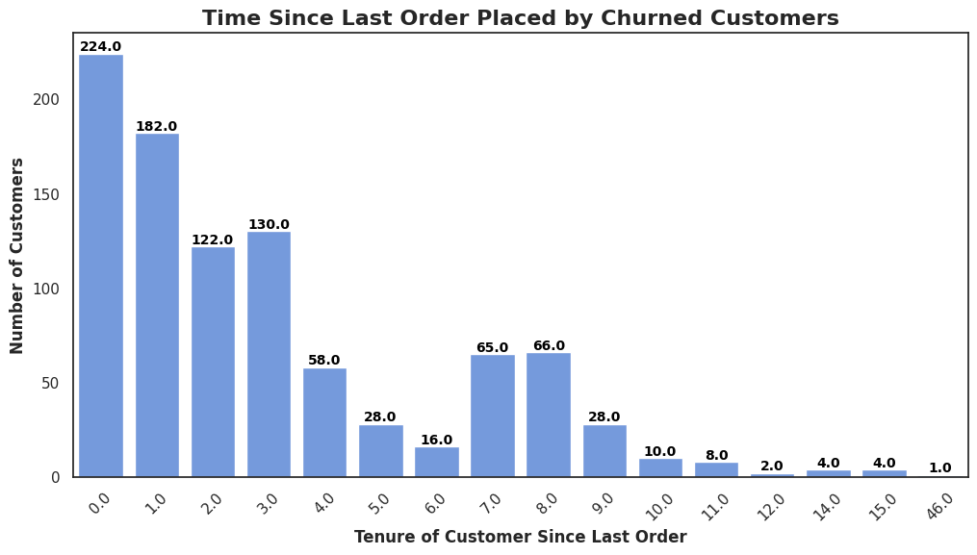
Analysis II – Tenure Distribution of Churned Customers
Inference: As per our analysis, majority of the customers who have churned out of the business left either at level 0 or level 1 after trying the products and services, while the churning rate seem to be significantly less as the days go by.
Recommendation: It seems like there is some lag in the products and services being offered to the welcoming customers. It could either be that they do not find the products they are looking for or they might not be getting timely customer service, which impacted their experience. The business could improve its services for the new customers by providing them better offers and/or instant customer service response to enhance their experience and hence retain them.

Slide 6
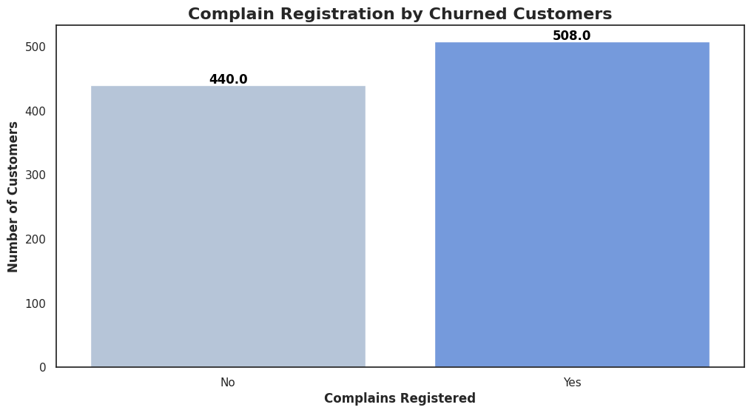
Analysis III – Complain Registration by Churned Customers
Inference: As per our analysis, there are more of Churned people who registered complains with the business.
Recommendation: It seems that people had some complains regarding the products and/or services and the business probably failed to address them. This could have probably contributed to their decision of leaving the brand. Thus, the business should improve the complain addressing policies and put methodologies in place to ensure that the complains are not just being heard/read but also resolved at a pace that is satisfying for the customers.

Slide 7
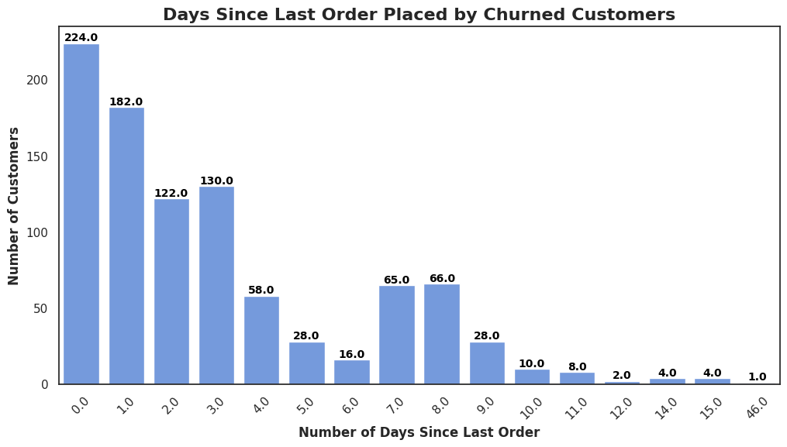
Analysis IV – Days Since Last Order Placed by Churned Customers
Inference: As per our analysis, more customers churned out immediately after their initial order placement with the business.
Recommendation: Since customers seem to be quick in making their decision regarding staying with the business or not, it is imperative for the brand to work on addressing the concerns and preferences of their new customers. It seems like once the customer stays with them, the chances of them leaving lessens. However, the business is struggling to retain new customers. So, they can probably give rewards to the new customers on first few purchases that can be redeemed in the subsequent purchases to ensure that they stay loyal to the business.

Slide 8
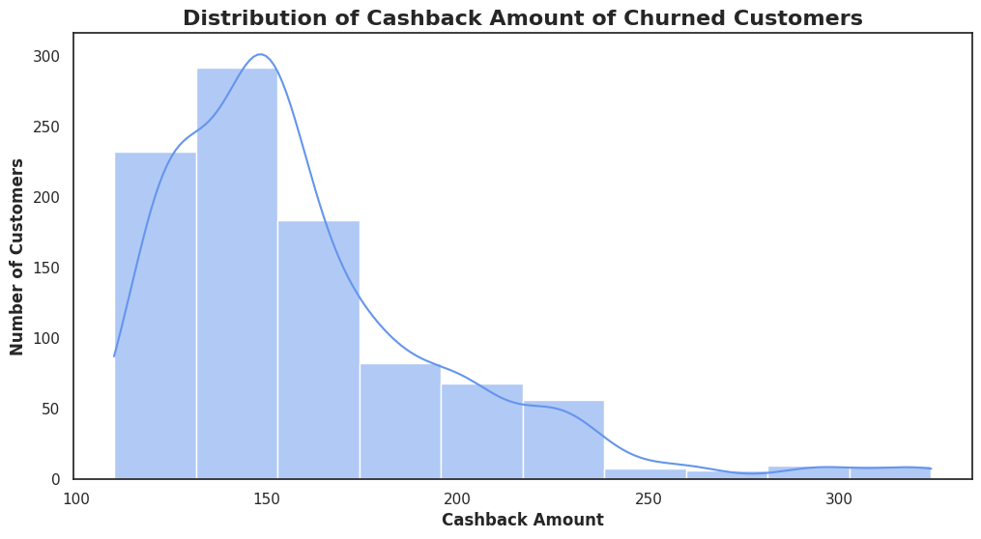
Analysis V – Distribution of Cashback Amount of Churned Customers
Inference: As evident, when customers received higher cashback amounts, they stayed with the business, while those receiving lesser cashback got churned away.
Recommendation: As the customers seem stay more when they are receiving higher rewards, the business can probably draft a policy to offer higher rewards to more customers. Alternatively, the business can improve its marketing campaigns and tell people about the higher rewards they can get in future, if they stay with the business for a longer period.

Slide 9
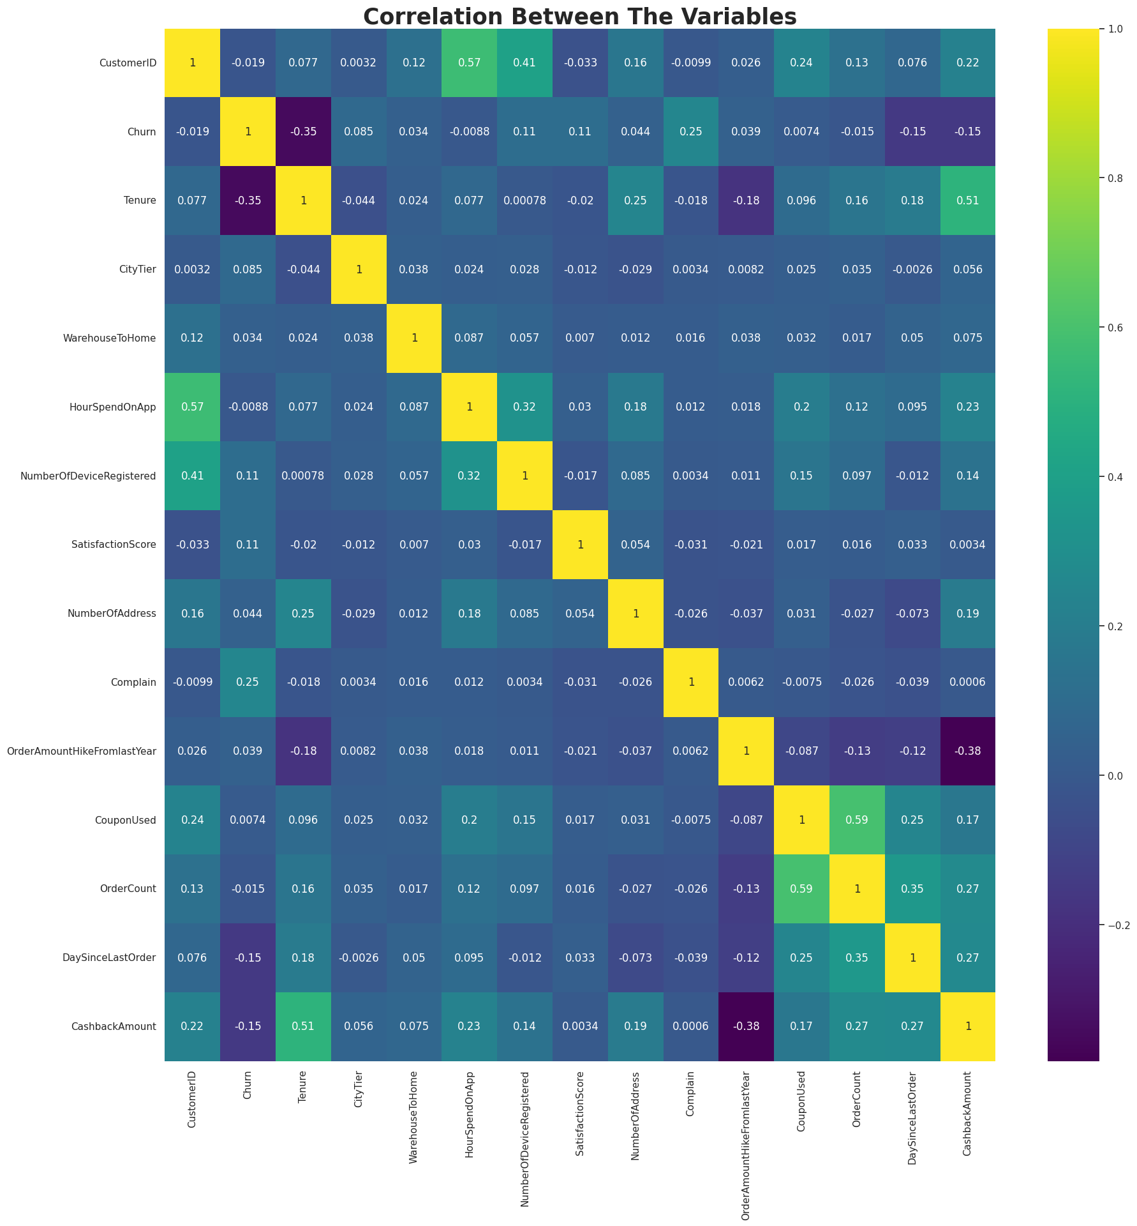
Factors Correlation Matrix
The correlation between each feature in the dataset is depicted by this heat map plot.
It is evident that there is a strong negative correlation between churn and tenure. It is -0.35.
The Churn and Complain features have the strongest positive correlation.
Thus, confirming are analysis that customers have been churned out majorly because of their complains were not addressed properly, and hence the businesses need to pay attention to that.

Slide 10
Methodologies of Machine Learning Used
Models Used: To analysis and predict the customer churn, we have used both the Decision Tree Classifier and Logistic Regression models.
Performance Metric: For the evaluation of evaluation, we have used the Accuracy metric as it aids us in achieving our goal of classifying whether a customer will be churned out or not.
Model Accuracy: We have achieved an accuracy of 95% with Decision Tree, while managing to get an 88% accuracy with our Logistic Regression Model. This indicates the both the models are effective and reliable in predicting customer churn.
Preferred Model: Considering the high accuracy and interpretability that was yielding through the Decision Tree Classifier (DecisionTreeClassifier), we recommend using that method over the other for the predicting the Customer Churn for the e-commerce business.

Slide 11

Considering all our analysis and learnings, we can sum up our study with the following points:
Churn Rate: More than 16% of the customers have churned out from the business during the period of observing data, which though not alarming, needs to be addressed so that the numbers don’t grow any further.
New Customers Churning: Each factor we analyzed ultimately resulted in the same finding that majority of the customers who churned out did so during their initial dealings with the business, thus emphasizing on the importance of providing better services and offers to the new customers.
Complains & Customer Service: As most of the customers who churned out registered complains with the business, it is imperative that the customer service and the way the complains are currently being addressed by the business are not satisfactory for the customers to stay. Thus, the brand needs to re-evaluate the complaint resolving methodologies to make them more customer-friendly.
Summary

